Slide 1
PREDICTING PREVELENCE OF DISEASE
PRESENTED By: Nagham Almaghout – Gift TEMBO

Slide 2
Step 1: Collecting and Preparing Data
Ground truth data: we used data from database of the US Center for Disease Control and Prevention (CDC).
This data aggregated from a specific country “US” in a specific time interval “2011-2016” for a selected disease “depression”
We used google trends and selected the relevant keywords for our prediction problem in the same time interval.

Slide 3
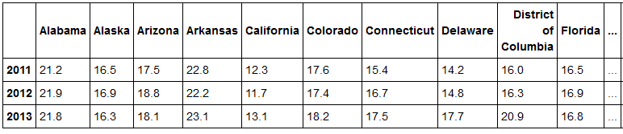
We firstly aggregated disease prevalence data in US states in each year:
Then got Google trends data using different keywords that are synonym somehow to the disease (Depression in our case) under study. Where here we got the prevalence of each keyword in each state.

Slide 4
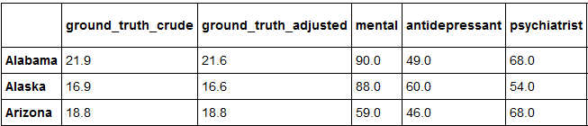

We integrated data from Google trends and groundtruth data into a single data frame.
Study the correlation between the ground truth data and the Google Trends data.
Then, we merged the data from different years.

Slide 5
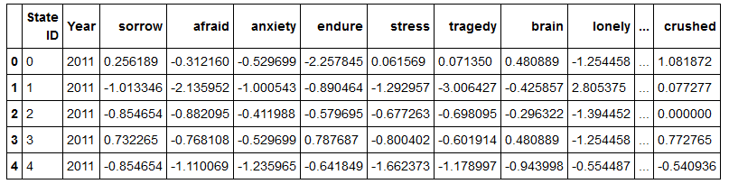
From the code below we impute the missing values and transform so that the data should have zero mean. The imputation is according to the mean strategy of the columns. We then use SKlearn standard scaler to standardize features by removing the mean and scaling to unit variance

Slide 6
Step 2: Modeling
RidgeCV
Bayesian Ridge
LassoCV
Linear Regression

Slide 7
Split the data for train and test sets according indices
Perform cross validation of spatial and temporal data cross validate in time("years") and space("US states")
Train the model and get R-squared score on prediction

Slide 8

RidgeCV

Slide 9

Bayesian Ridge

Slide 10

LassoCV

Slide 11

Linear Regression

Slide 12
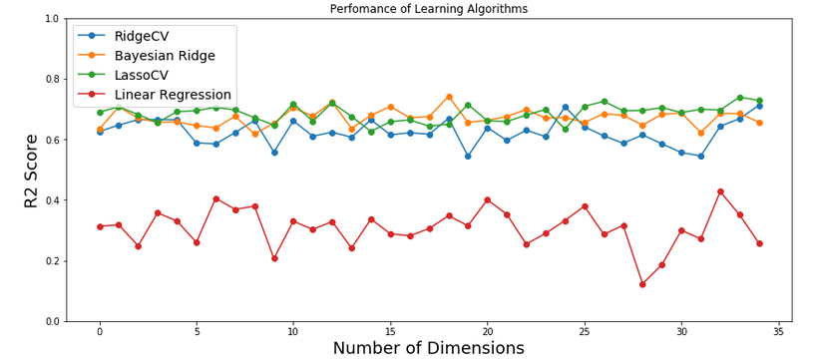

Slide 13
